Slide 1

Do consumers spend more money in Online Shopping than visit In-Stores ?
Survey topic

Slide 2
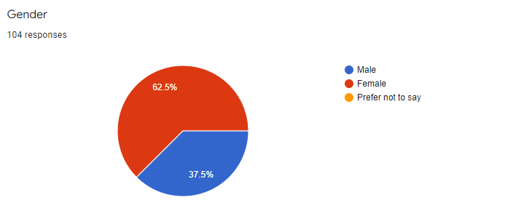
Descriptive statistics:
Total number of Responses are 104

Slide 3
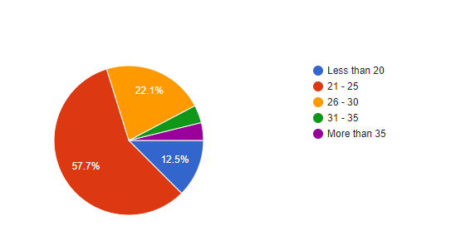
Age:

Slide 4
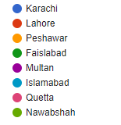
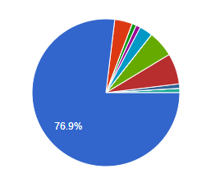
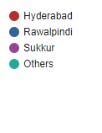
City:

Slide 5
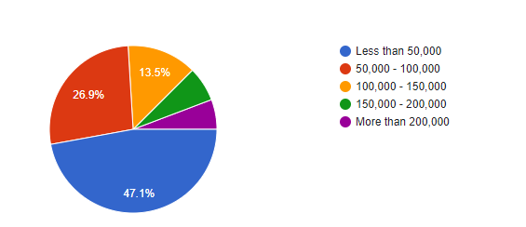
Monthly income:

Slide 6
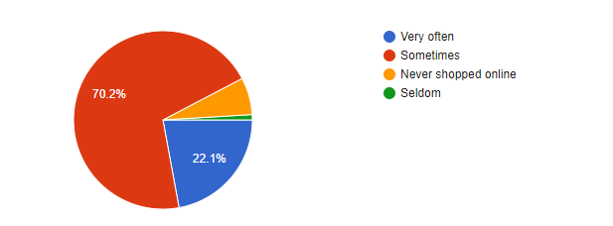
How often do you shop online?

Slide 7
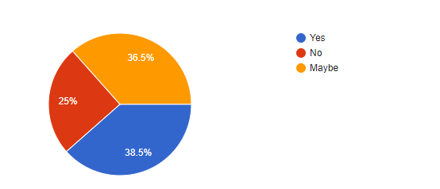
Do you prefer online shopping?

Slide 8
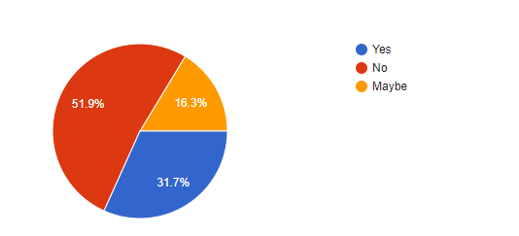
do you think you buy unnecessary things and spend more money in online shopping as they are a click away?

Slide 9
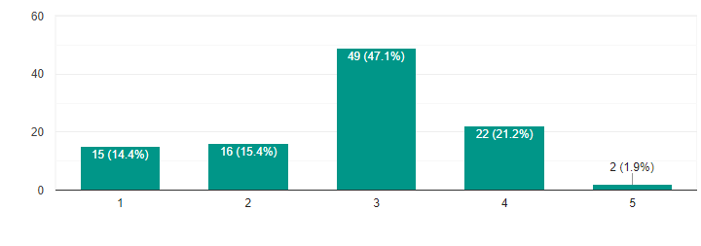
How much do you trust online stores?

Slide 10
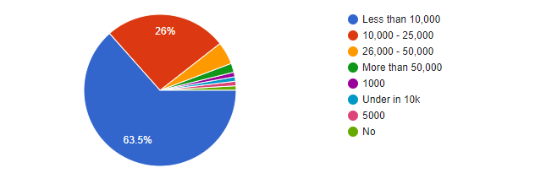
How much amount on average you spend on physical shopping in a month?

Slide 11
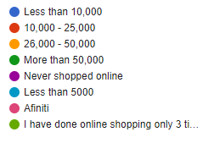
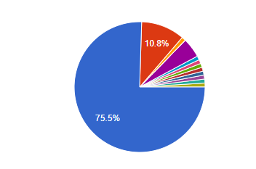
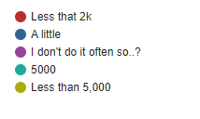
How much amount on average you spend on online shopping in a month?

Slide 12
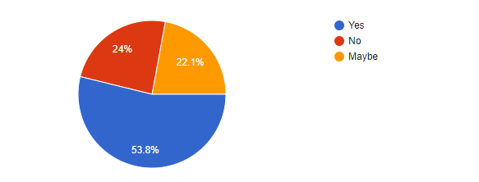
Do you get convince when you are offered discounts or installments on online stores?

Slide 13
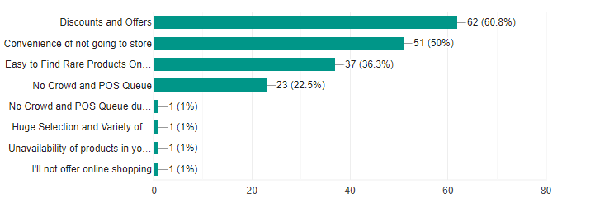
If you prefer online shopping, what are the important reasons?

Slide 14
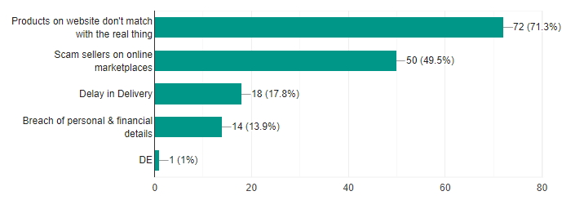
If you don't prefer online shopping, what are the main reasons?

Slide 15
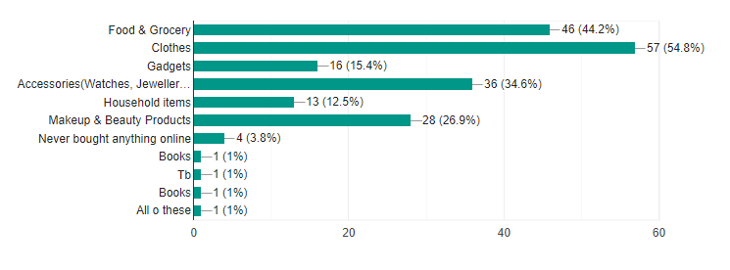
What products do you buy online mostly?

Slide 16
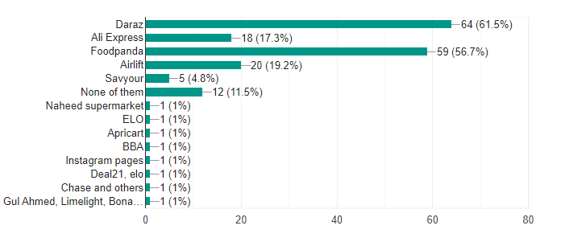
Which stores do you prefer to shop online?

Slide 17
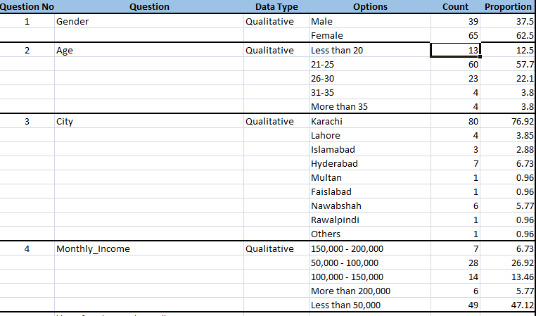
Descriptive summary table:

Slide 18
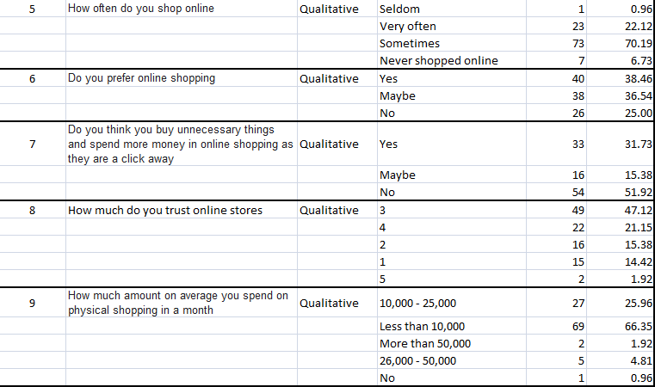
Cont:

Slide 19
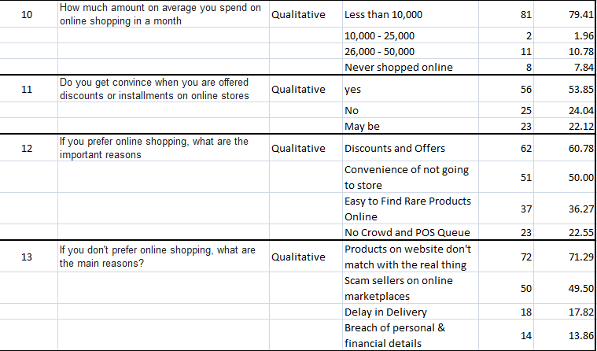
Cont:

Slide 20
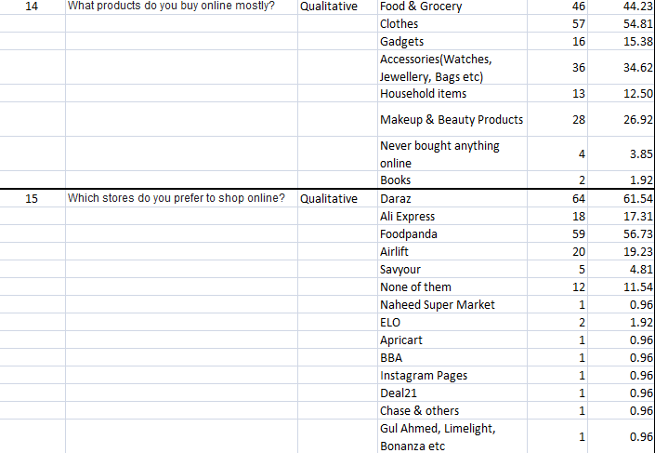
Cont:

Slide 21
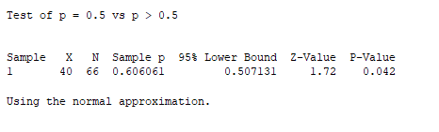
Statistical tests:
Do you prefer online shopping ? (1 proportion test)
Results: As P-Value < 0.05, therefore we reject Ho and accept H1. This indicates that more people prefer online shopping.

Slide 22
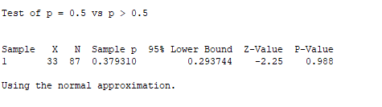
Statistical tests:
Do you think you buy unnecessary things and spend more money in online shopping as they are a click away?(1 proportion test)
Results: As P-Value > 0.05, therefore we reject H1 and accept Ho. This indicates that people do not buy unnecessary things and spend more money in online shopping.

Slide 23
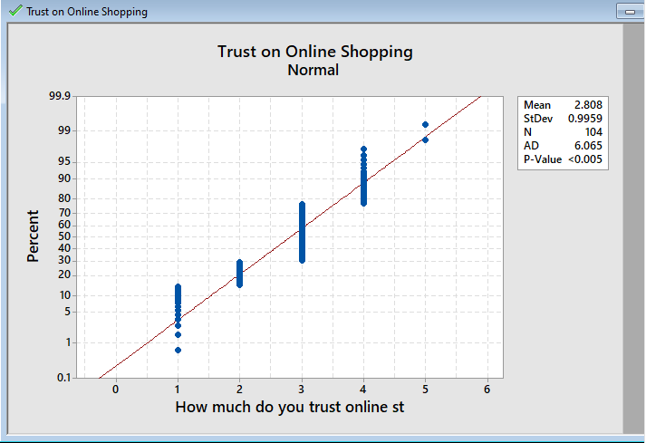
Statistical tests:
How much do you trust online stores ?(Normality test)
Results: As P-Value < 0.005 therefore, it indicates that data is not normally distributed.

Slide 24
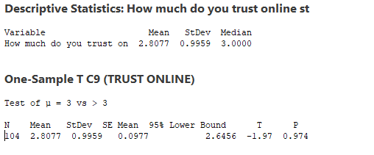
Statistical tests:
How much do you trust online stores ? (Mean test)
Results: As P-Value > 0.05, therefore we reject H1 and accept Ho. This indicates that people trust on online stores is average (Neither so good nor so bad).

Slide 25
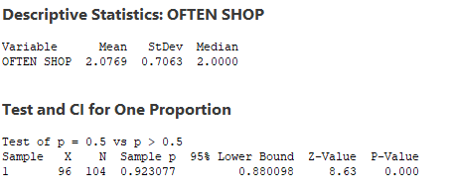
Statistical tests:
How often do you shop online ? (Mean test)
Results: As P-Value < 0.05, therefore we reject Ho and accept H1. This indicates that more than 50% of people shop online.

Slide 26
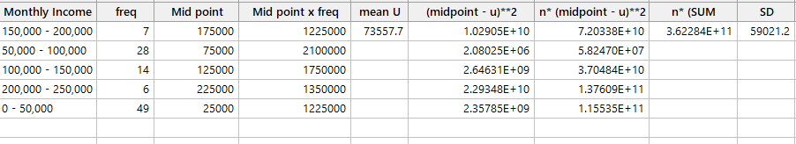
Statistical tests:
Monthly Income ? (Group data)

Slide 27
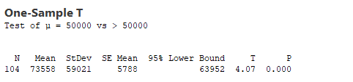
Statistical tests:
Monthly Income ? (Mean test)
Result: As P-Value < 0.05, therefore we reject Ho and accept H1. This indicates that mean monthly income of people greater than 50,000.

Slide 28
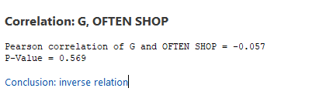
Statistical tests:
Correlation factor between Gender and Often Shop?

Slide 29
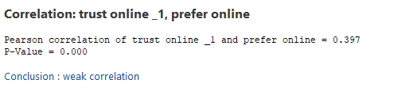
Statistical tests:
Correlation factor between trust online and prefer online?

Slide 30
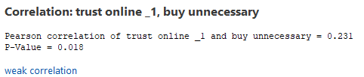
Statistical tests:
Correlation factor between trust online and buy unnecessary?

Slide 31
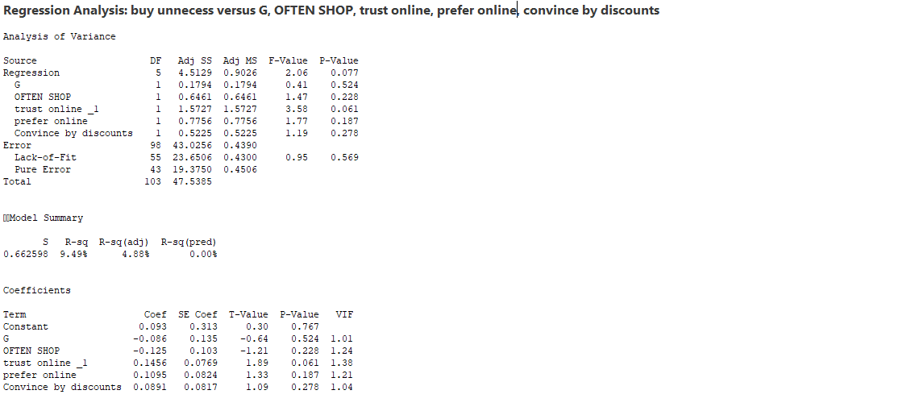
Statistical tests:
Regression test

Slide 32
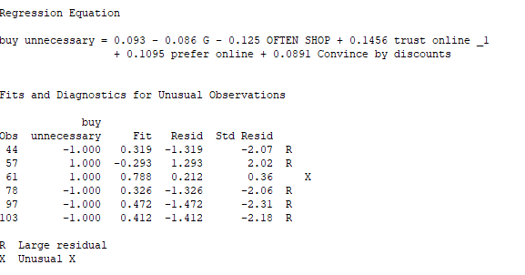
Statistical tests:
Regression test

Slide 33
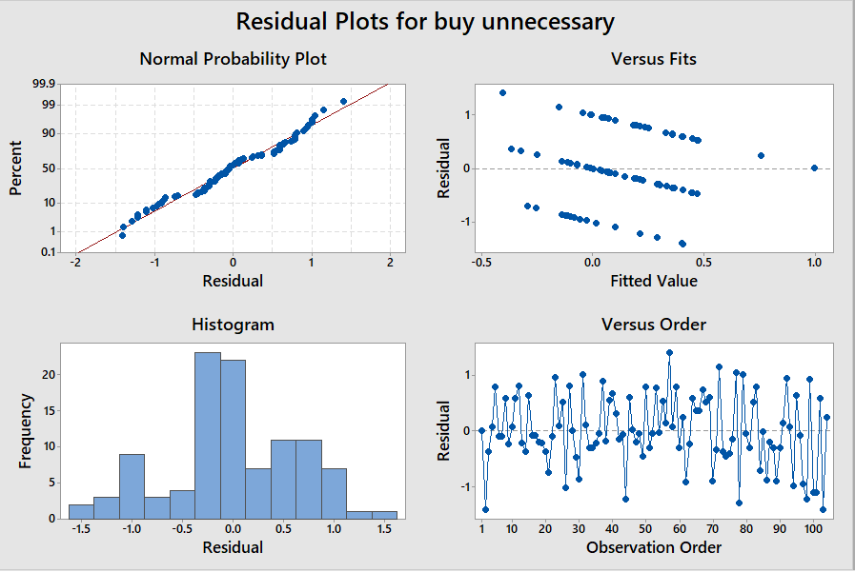
Statistical tests:
Regression test

Slide 34
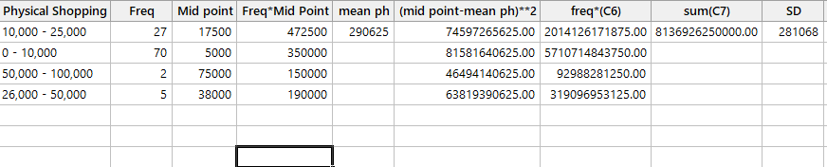
Statistical tests:
How much amount on average you spend on physical shopping in a month? (Group data)

Slide 35
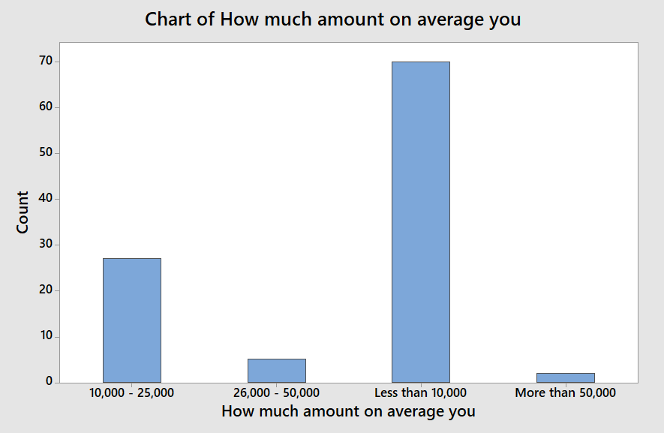
Statistical tests:
Cont:

Slide 36
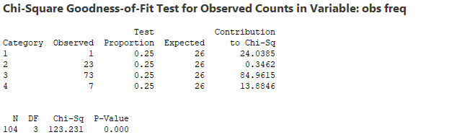
Statistical tests:
How often do you shop online ? (Chi-Square Goodness-of-fit test one variable)
Result: As Chi-Sq value is greater than its table value and P-value < 0.05. Therefore, we reject Ho and accept H1(that means : there is difference between observed and expected frequency).

Slide 37
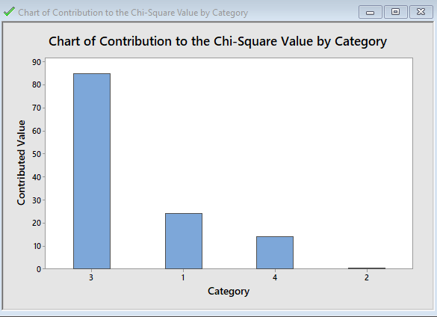
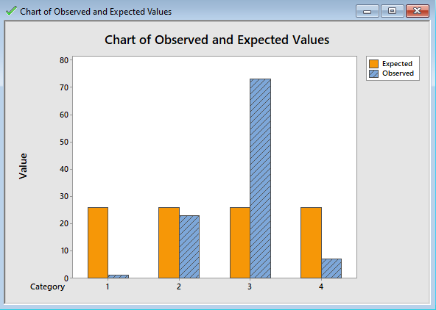
Statistical tests:
How often do you shop online ? (Chi-Square Goodness-of-fit test one variable)

Slide 38
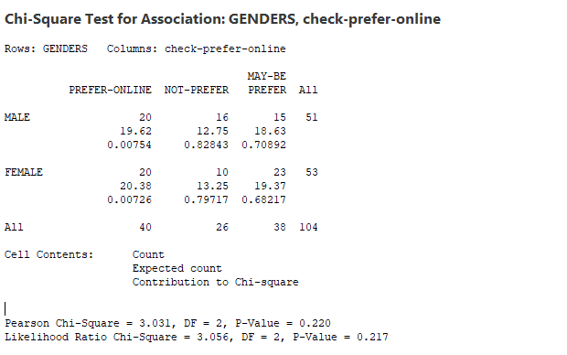
Statistical tests:
Chi-Square Test for Association: GENDERS vs. check-prefer-online :
Result: As Chi-Sq value is less than its table value and P-value > 0.05. Therefore, we reject H1 and accept H0 (that means : there is no association between genders and online shopping preferences).

Slide 39
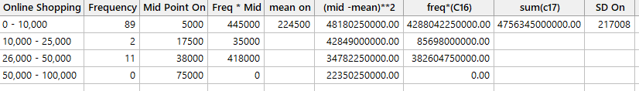
Statistical tests:
How much amount on average you spend on online shopping in a month? (Group data)

Slide 40
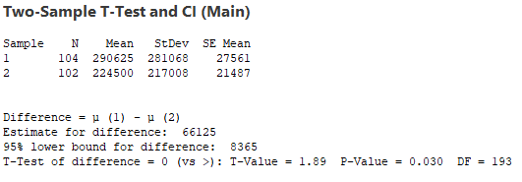
Statistical tests:
Two Mean test (physical amount – online amount)
Result: As P-Value < 0.05, therefore we reject Ho and accept H1. This indicates that people spend more money in physical shopping than online.

Slide 41


